Slide 1
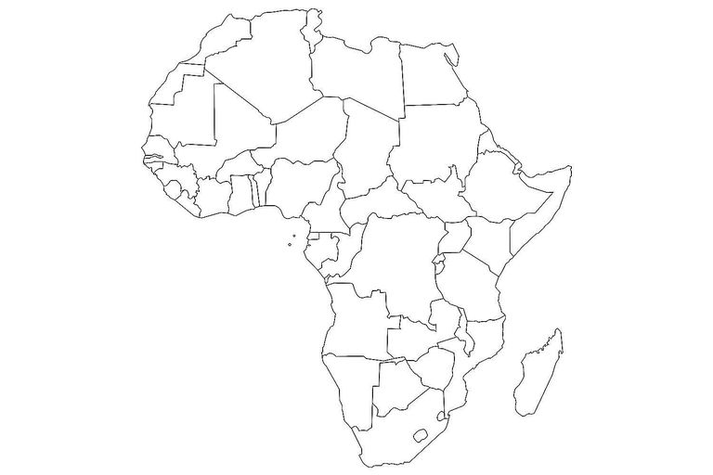
Poverty, Economy and Life Expectancy in African Context
Olayinka Akerekan
14th May, 2023

Slide 2

01 | Problem Statement and Objectives
02 | Introduction
03 | Dataset Description
04 | Exploratory Data Analysis
05 | Conclusion and Recommendations

Slide 3
PROBLEM STATEMENT
This project seeks to explain the relationship between poverty, life expectancy and the GDP of a country with the African context, looking at them microscopically regionally, and making meaningful recommendations

Slide 4
INTRODUCTION…
According to the IMF, a state of living below $1 Per day is know as Poverty, and it can be characterized by the absence of drinking water or food
In 2013, the United Nations came up with a Framework consisting of 17 main component, of which No poverty was clearly highlighted as a goal to this end, we will be analyzing the dataset to measure the impact of GDP on Poverty and Life expectancy.
This framework is known as the sustainable development Goal(SDG).

Slide 5
PROCESS WORKFLOW
STEP 1
STEP 2
STEP 3
STEP 4
Getting and Preparing Dataset
Data Cleaning
Exploratory Data Analysis
Summary and Conclusion

Slide 6
DATASET DESCRIPTION
The dataset used for this project was provided by the 10Alytics Team
Contain data from four excel Workbooks - population-xlsx, GDP.xlsx, Country Code.xlsx, life expectancy.xlsx
The data is for the period, 1960 - 2021
Here is the shape of the population, GDP, Life, Country Code ((239, 11), (54, 64), (3937, 3), (54, 4))
Let get straight to business…

Slide 7
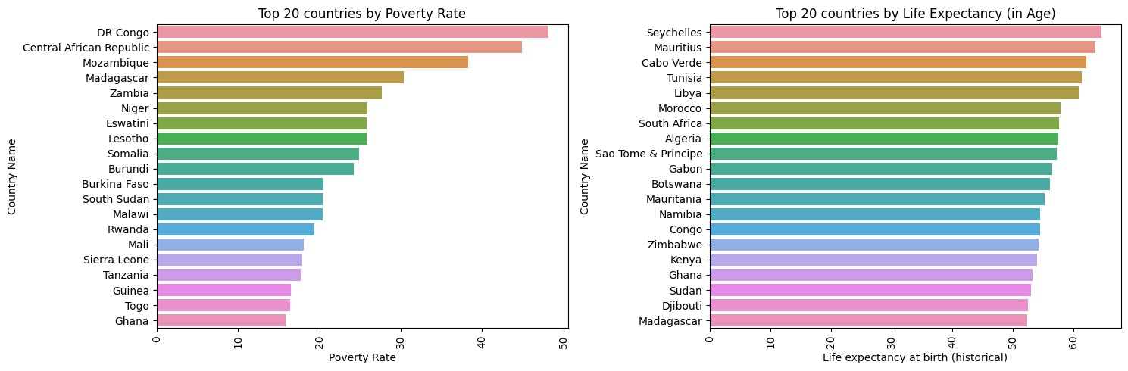
INFORMATION FROM EDA
The EDA was plotted with the python libraries seaborn, captures the top 20 nations with Poverty Rate and Life Expectancy.

Slide 8
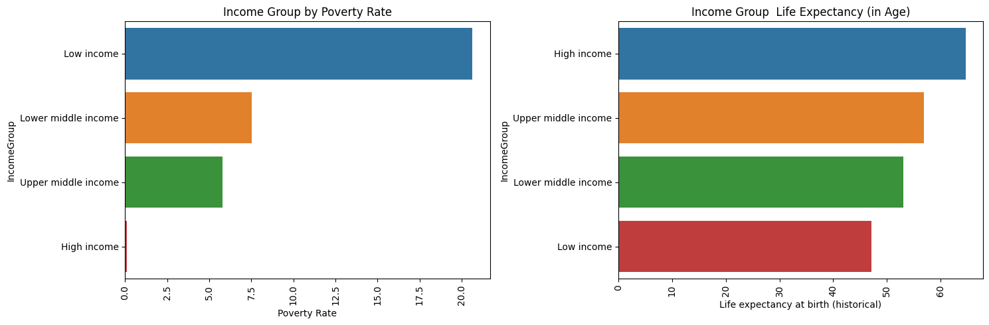
INFORMATION FROM EDA
The charts shows the correlation between the Income group, life Expectancy and Poverty
The people with higher income generally lived longer than the people with the lower income, and are less likely to be in poverty since they have higher income

Slide 9
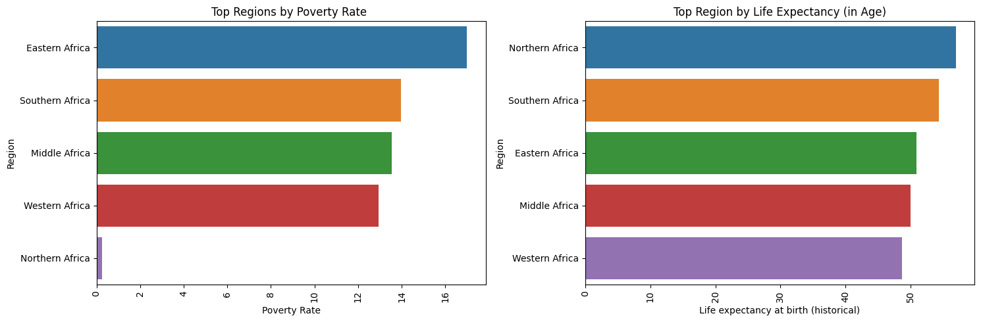
EDA
This is a plot of the poverty and life expectancy, From this chart we could clearly see an inverse relationship with Poverty and Life expectancy. Region with higher life expectancy are generally less poorer than other

Slide 10
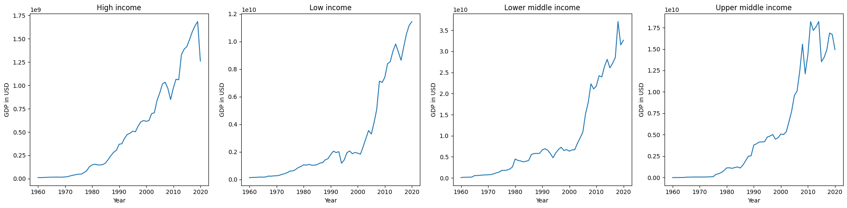
EXPLORATORY DATA ANALYSIS
The GDP of high income nations are seems not to be following the pattern set out in the book, as lower middle nation have the GDP in the last years, followed closely by upper middle class and High Income, The low income countries comes last.

Slide 11
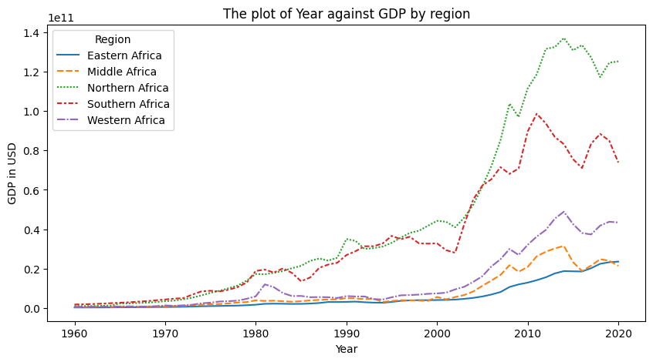
EDA
The GDP according to region have continued to increase over the year, with the North leading the Pack, although their growth more need to be done

Slide 12
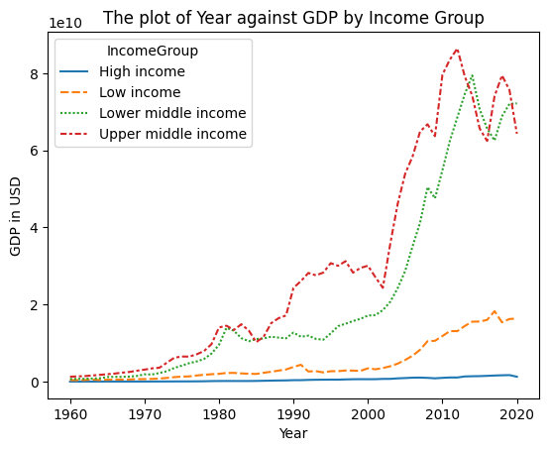
EDA
The income group generally come from Countries with the highest GDP, and the GDP have been steadily increasing over the year

Slide 13
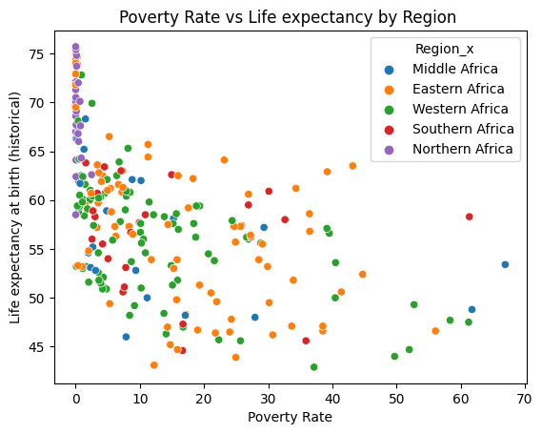
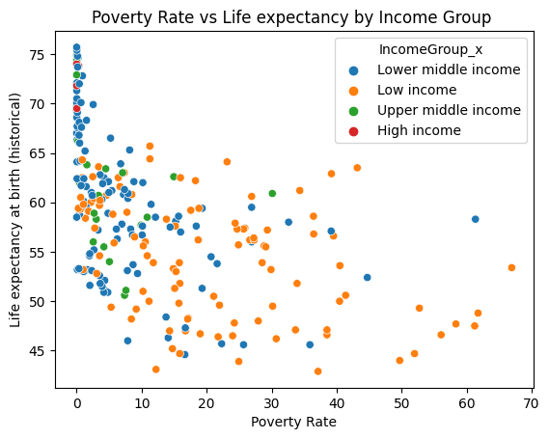
EDA
Life expectancy is negatively correlated with number of people below the poverty line, such as more people are below the poverty line in a region. The people will higher income tends to live longer, because they are prolly afford healthcare

Slide 14
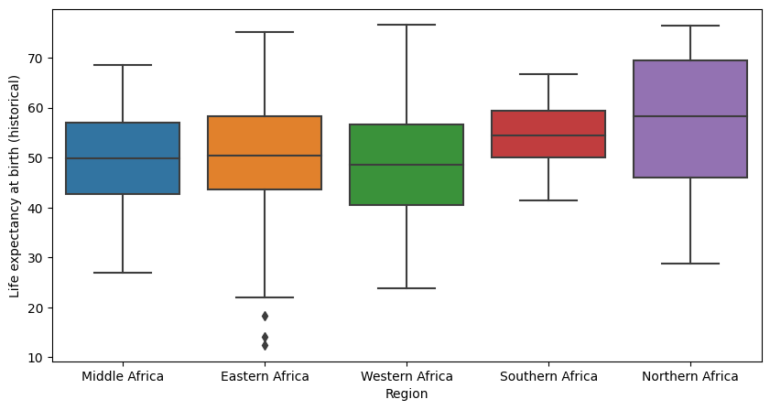
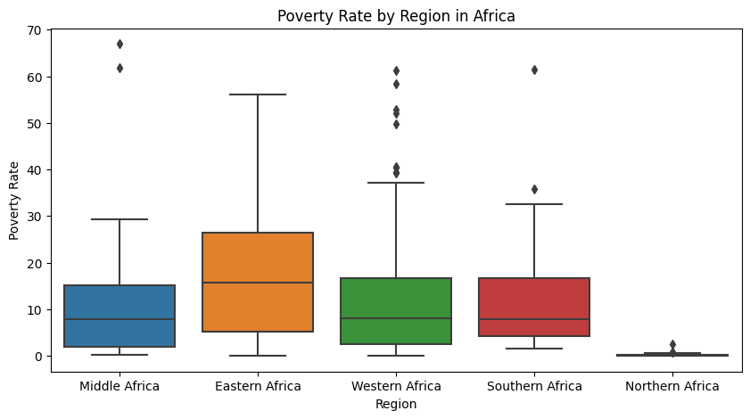
EDA
North African generally have a higher median Life expectancy than those from other regions
Eastern Africa have the highest Poverty Rate in this research and so, also the lower life expectancy

Slide 15
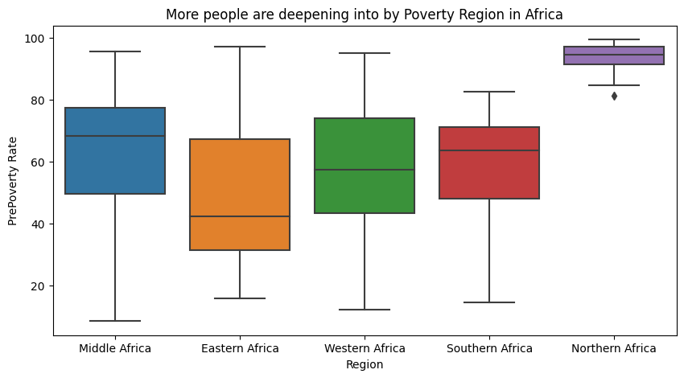
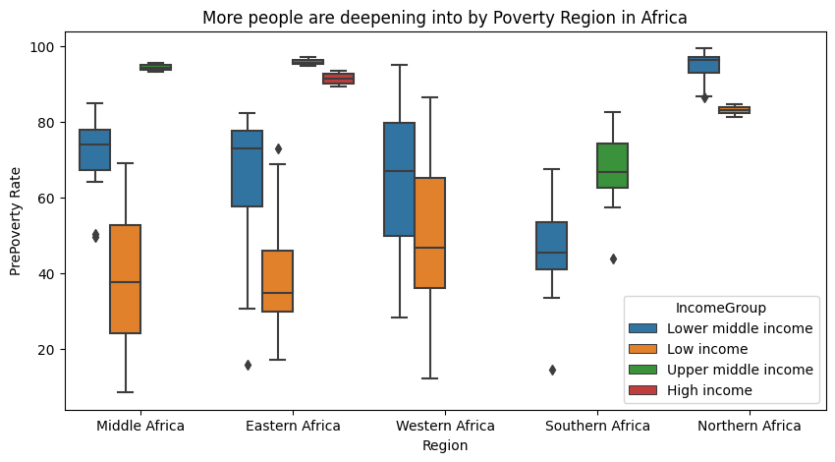
EDA

Slide 16
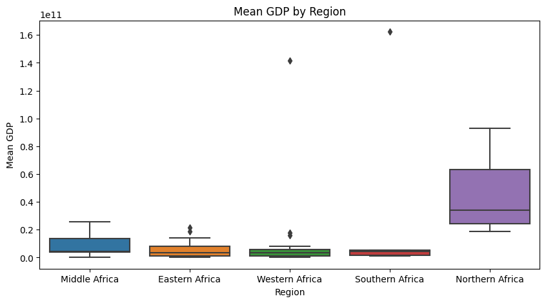
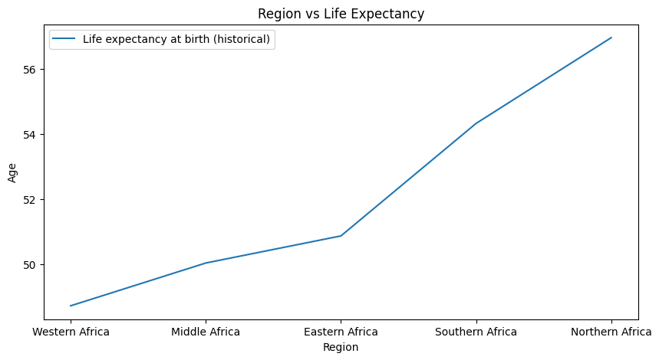
EDA
The Mean GDP of North Africa stands out clear from the rest of Africa, and so their life Expectancy, a lot could have contributed to this not captured in this study

Slide 17
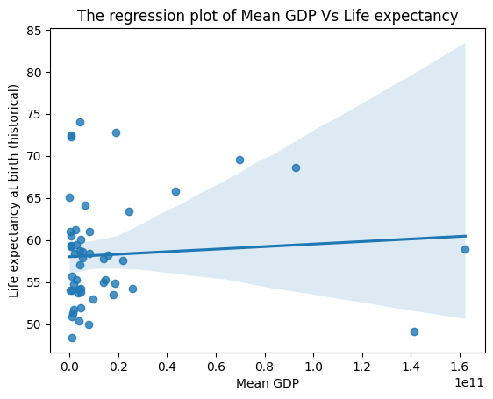
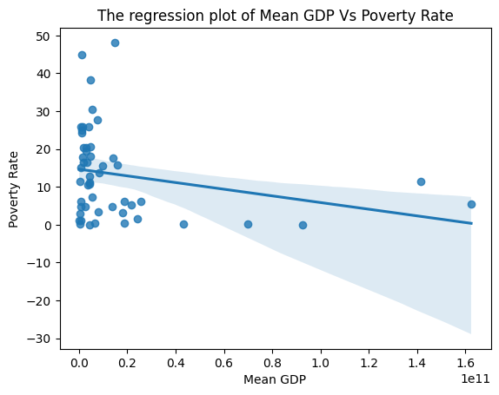
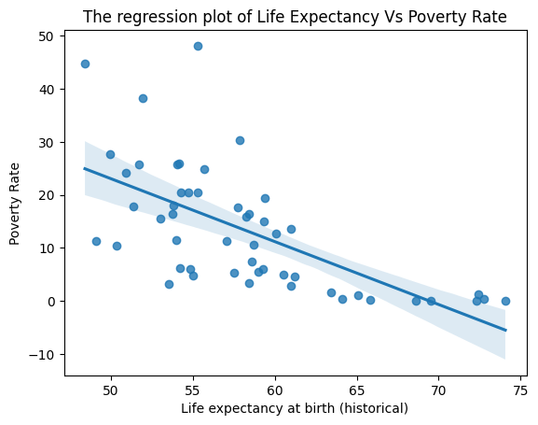
EDA - correlation and Regression plot
R > 0,
Weakly
Positively Correlated
R < 0,
Weakly
Negatively Correlated
R > 0,
Strongly
Negatively Correlated

Slide 18
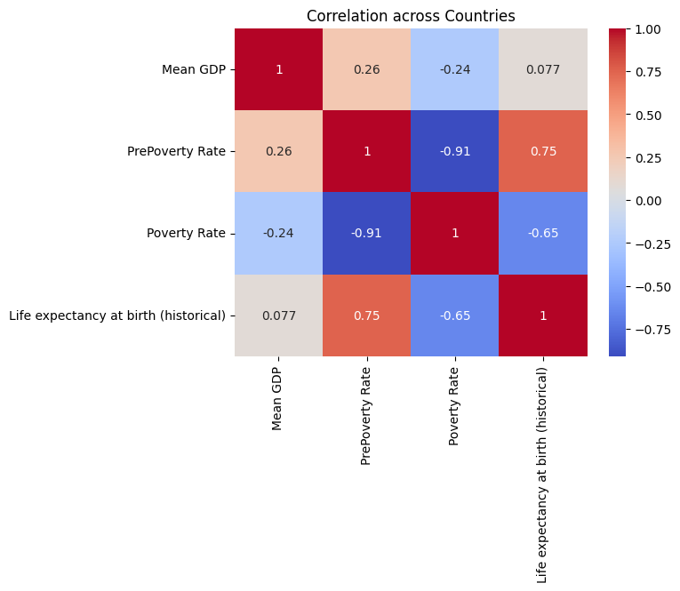
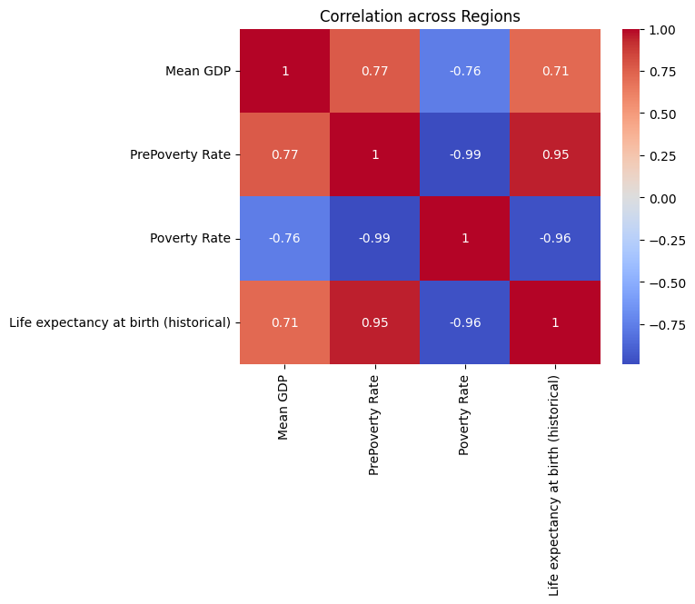
EDA - correlation

Slide 19
RECOMMENDATIONS
Increase investments in healthcare: One of the key factors affecting life expectancy is access to healthcare. Increasing investments in healthcare infrastructure and services can help improve the health outcomes of the population and increase life expectancy. Based on finding Life expectancy is generally low across Africa, but lower in the middle and Eastern African region.
Implement poverty reduction programs: Poverty can have a negative impact on both life expectancy and GDP. Implementing programs that help lift people out of poverty, such as job training and education initiatives, can help to improve economic conditions and increase life expectancy. Implementing. Poverty is negatively correlated to longer life expectancy, if you are poor, you are less likely to live long.

Slide 20
RECOMMENDATIONS
Promote economic growth: GDP is an important measure of a country's economic health. Policies that promote economic growth, such as reducing barriers to trade and investment, can help to improve GDP and potentially reduce poverty. From our research, GDP have been increasing over the years but more still need to be done, as 1% can lead to approximately 0.77% decrease in poverty rate and 0.07% increase in life expectancy
Improve access to education: Education is closely linked to poverty and economic growth. By improving access to education, countries can help to reduce poverty, increase economic opportunities, and improve overall quality of life.
Focus on sustainable development: Sustainable development can help to address poverty, improve health outcomes, and promote economic growth in a way that is environmentally sustainable. Policies that prioritize sustainability, such as investments in renewable energy and conservation efforts, can help to create a more equitable and sustainable future for all.

Slide 21
CONCLUSION
Although most time, Correlation may not infer causation, but it thus says a lot about a relationship between them and other factors which may not be covered in this study.
In conclusion, a higher GDP will likely lead to higher life expectancy and reduced poverty rate in African Countries.

Slide 22


